Slide 1
Direct Geometry Processing for Tele-Fabrication
Yong Chen*, Kang Li#, Xiaoping Qian#
* Epstein Department of Industrial and Systems Engineering,
University of Southern California, Los Angeles, CA 90089
# Department of Mechanical, Materials and Aerospace Engineering,
Illinois Institute of Technology, Chicago, IL
2012 CIE Conference, Chicago, IL
Aug. 13, 2012

Slide 2
CONTENTS
Introduction of 3D tele-fabrication
3D data acquisition
Geometry processing
Point cloud slicing
Support generation
Mask image planning
Fabrication results and discussion
Summary
2

Slide 3




2D Faxing
2D Scanning (Chicago)
Printing (Los Angeles)
3

Slide 4
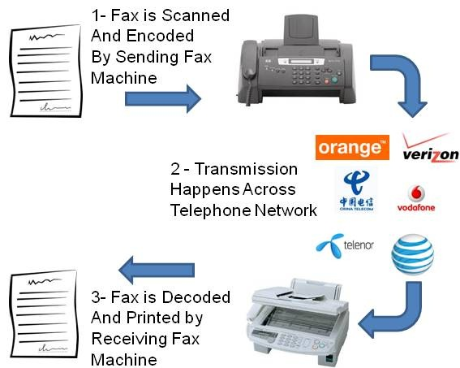
2D Faxing Processing
4

Slide 5
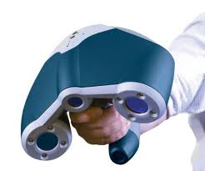
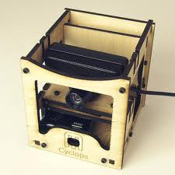
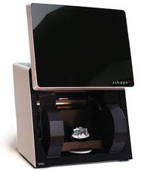
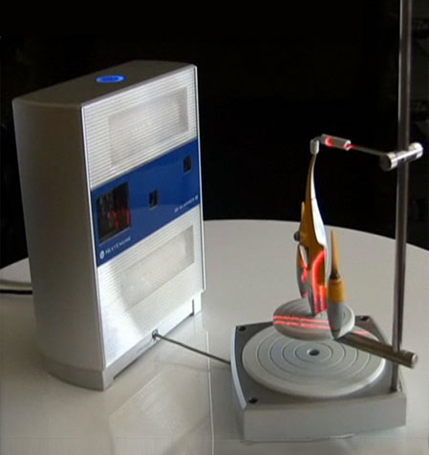
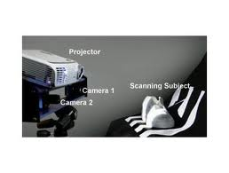
3D Scanners
Zcorp
Makebot 3D replicator
NextEngine
3Shape
HDI 3D Scanner
etc.

Slide 6
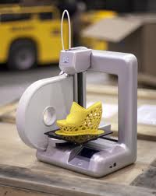

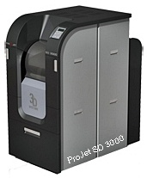
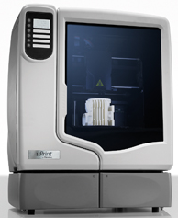
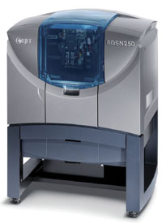
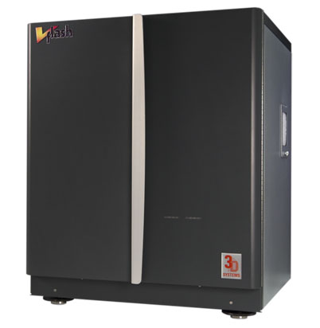
3D Printers
Cubify
VFlash
Perfactory
ZCorp
Objet
Projet
uPrint
etc.

Slide 7
3D Faxing
Geometry processing
Points
Polygonal meshes
(STL)
3D Scanners
?
3D Printers
An open question: how should geometry be processed in future 3D faxing systems?

Slide 8
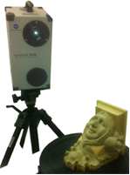
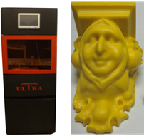
3D Tele-fabrication overview
Point cloud slicing
Support generation
Mask image
planning
3D Scanning (Chicago)
Geometry processing
Manufacturing
(Los Angeles)
8

Slide 9
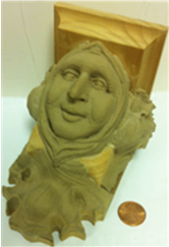
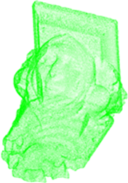
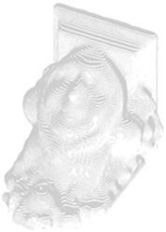
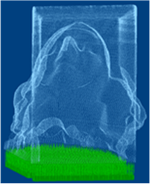
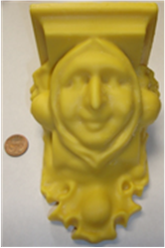
Geometry processing flowchart
Physical
object
Scanned
point data
Sliced contours
Support structure
Manufactured model
Chicago
Los Angeles
9

Slide 10
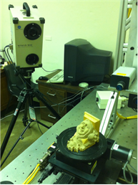
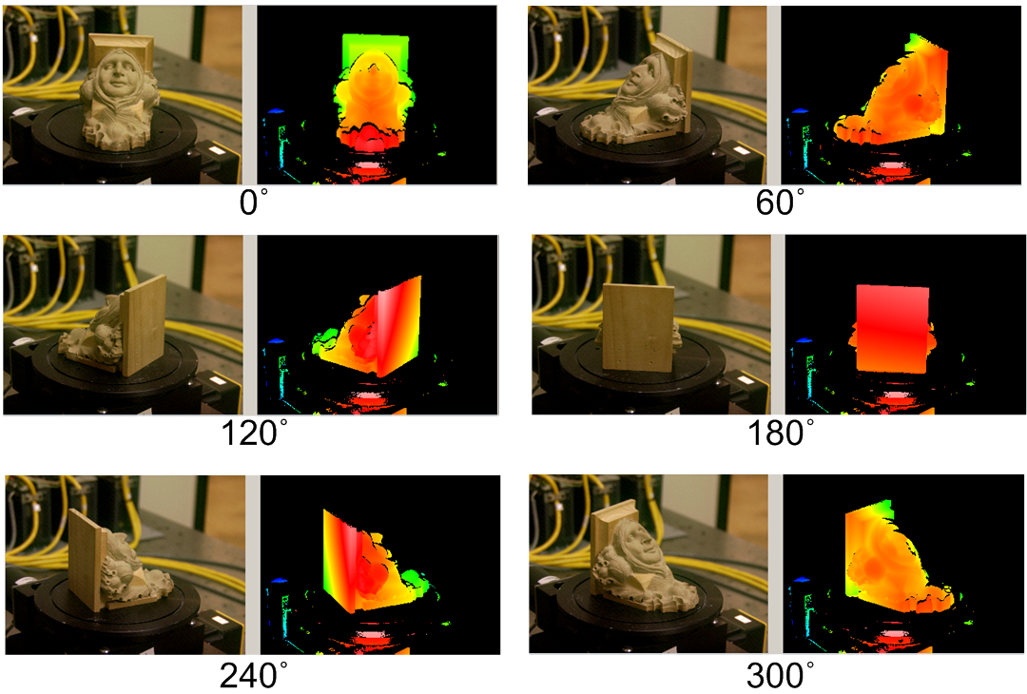
Data acquisition
3D digitizer
Computer
Object
Rotary stage
Digitizing system
6-step range image scanning
10

Slide 11
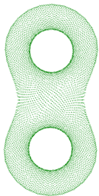

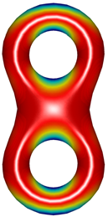
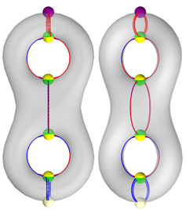
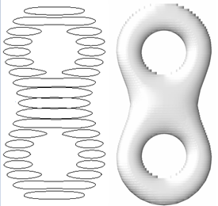

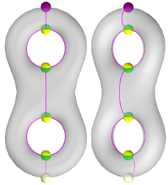
Point cloud slicing overview
Point cloud
Morse function and MLS surface
Critical points and
Morse-Smale complex
Sliced model
Enhanced Reeb graph
11

Slide 12
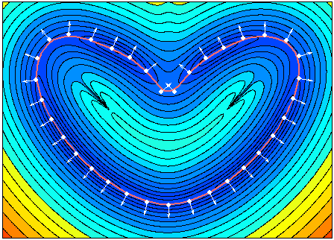
Moving Least Square (MLS) surface
Implicit definition stationary set
of a projection operator
Energy function
Energy function and
normal vector field
Normal vector field
MLS explicit definition
MLS surface point with local minimum energy
12

Slide 13
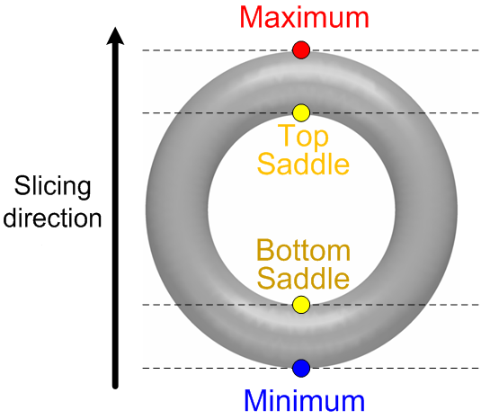
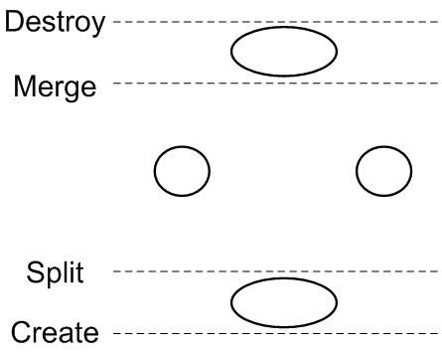
Critical points
Morse function
f: height value
φ on MLS
4 types of critical points
Contour topology
Critical points identified by:
Slicing contour topology controlled by critical points
13

Slide 14
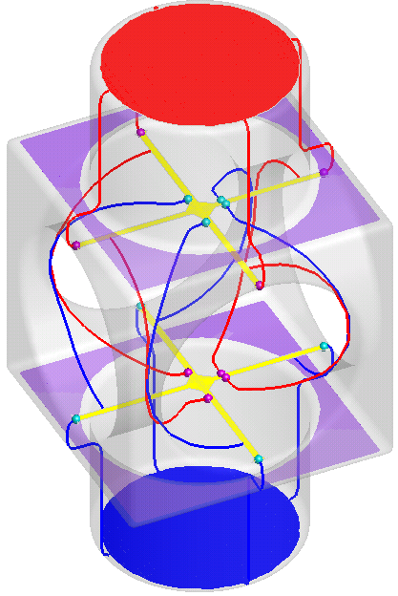
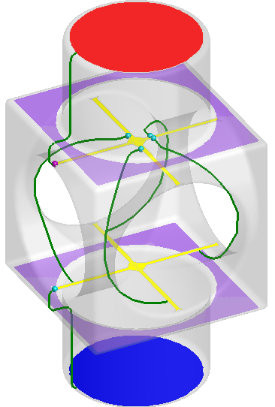
Morse-Smale complex and enhanced Reeb graph
Grouping / Pruning
MS complex:
integral lines tracing
Enhanced Reeb graph:
MS complex re-organizing
Morse-Smale (MS) complex: tracing integral lines
from saddles to maximum/minimum
Enhanced Reeb graph: graph processing of MS complex
14

Slide 15
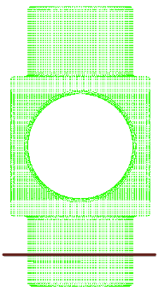
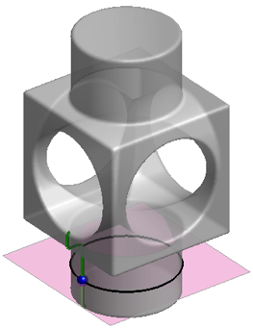
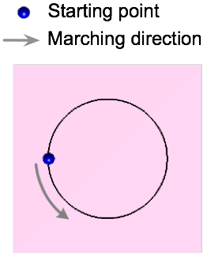
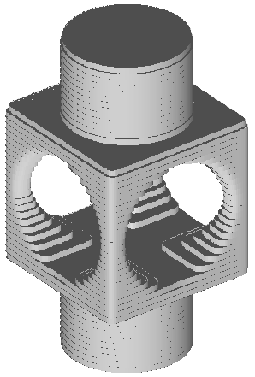
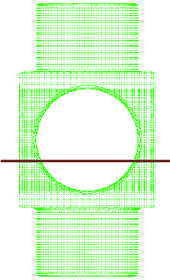
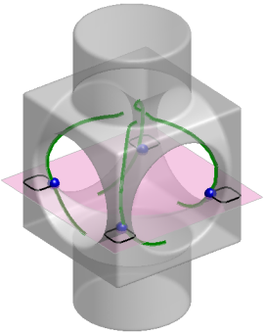
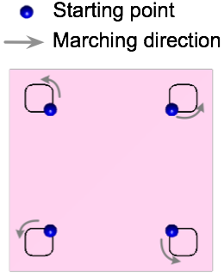
Enhanced Reeb graph as contour marching start
Sliced model: all raised contours stacked
Slicing plane
Intersection with enhanced Reeb graph
Contour marching from intersected point
15

Slide 16
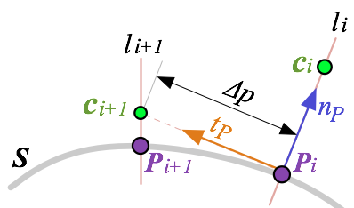
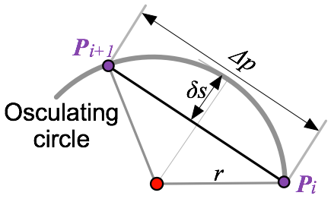
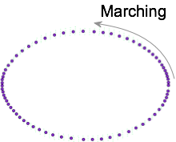
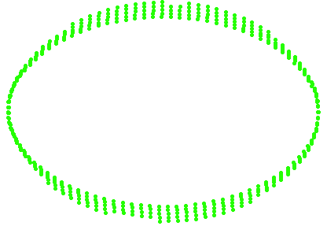
Curvature-adaptive contour marching
Contour marching by intersection
Curvature-adaptive step size
Point subset near the slicing plane
Adaptive contour points generation
Step size determined by osculating radius
16

Slide 17
Support generation based on contours
Supports are required to ensure the success of the 3D printing process
No drifting/floating away;
Reduce deformation due to shrinkage.
17

Slide 18

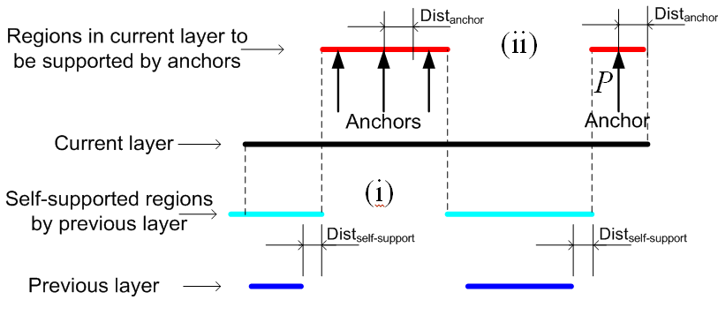
Contour-based support generation principle
Two consecutive layer contours
Support structure analysis
18

Slide 19

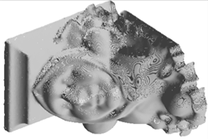
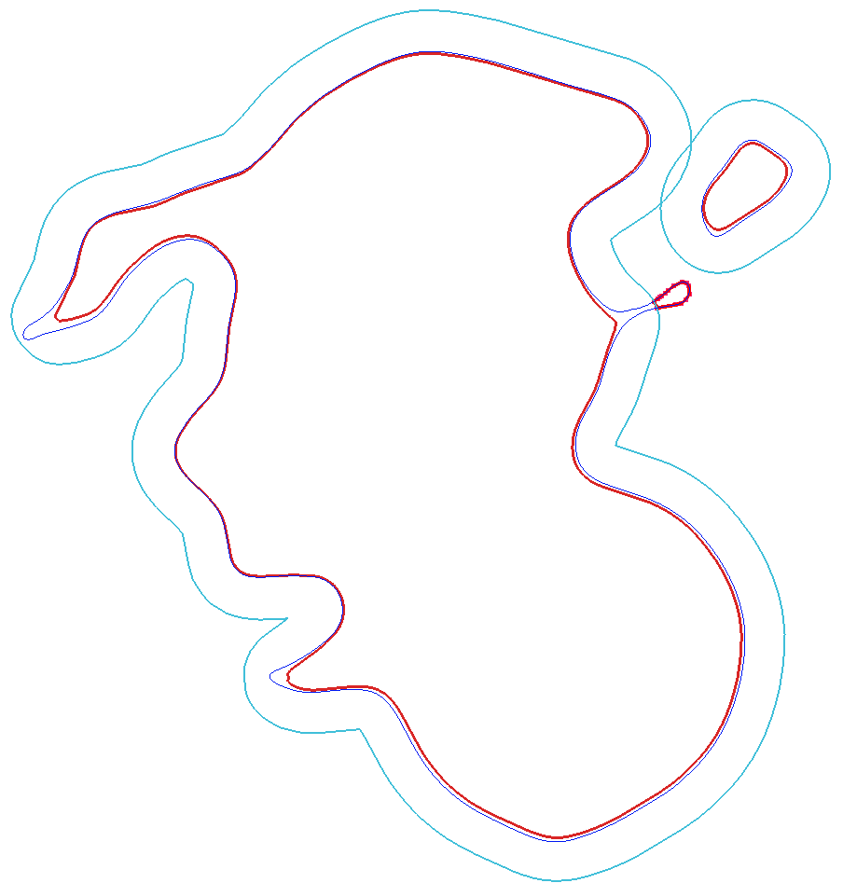


Support generation algorithms
C = A ∩ B
1
B
A
4
B
Sanchor
= B - Sself
r
2
A
D = C offset by r
Current layer B
A
3
Sself = D ∩ B
Previous layer A
Sanchor : anchor-support region
Sself : self-support region
19

Slide 20
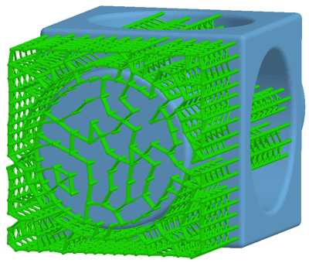
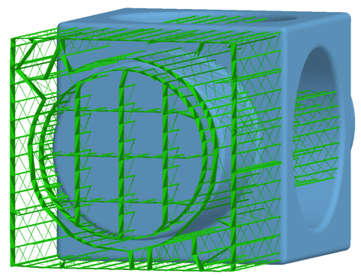
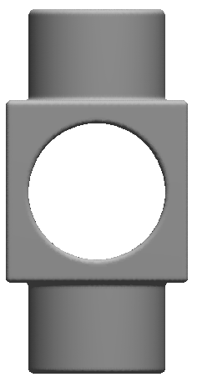
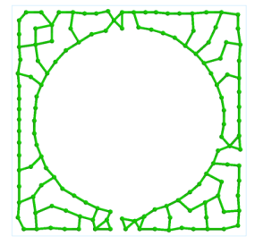
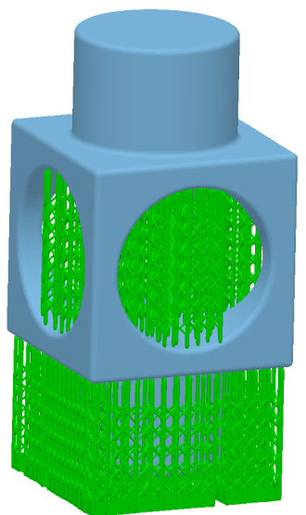
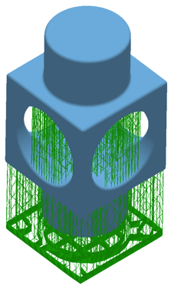


Anchor-support region covering
B
B
A
A
Input regions
Support layout by region covering
CAD model of supports
(Contours based)
CAD model of support
by Lightyear system
(STL based)
20

Slide 21



Support generation examples
Sliced model
Point cloud
Support structure
21

Slide 22









Mask image planning: Image projection of layers
Layer ID | 1 | 100 | 200 | 300
Mask image of part
Mask image of support
Projection mask image
22

Slide 23



Fabrication example
(1)
(2)
Point cloud
Sliced model
Fabricated model
23

Slide 24

Manufacturing compatibility with different layer thickness
Macro-
Meso-
Micro-
24

Slide 25
Summary
Tele-fabrication is critical for future product design and manufacturing
Developed a tele-fabricating approach by integrating 3D scanning and printing
Presented a direct geometry data flow method in such an integration system
Performed physical experiments to verify the effectiveness of the direct geometry method.
25

Slide 26
Acknowledgments
National Science Foundation CMMI-0927397 (USC).
National Science Foundation CMMI-0900597 and CMMI-1030347 (IIT)
26

Slide 27
Questions?
27

